Slide 1
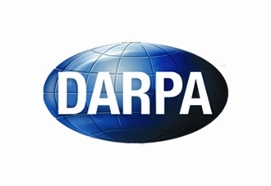

On Organic Neural Learning
Vahid Tarokh (P.I.)
Jie Ding, Enmao Diao
DARPA FUNLOL Meeting
June 27, 2018
Acknowledgement: Part of the slides are through the courtesy of Dr. Gimlett and Dr. Kumar during the FunLoL PI meeting at USC, June 19-21, 2018

Slide 2
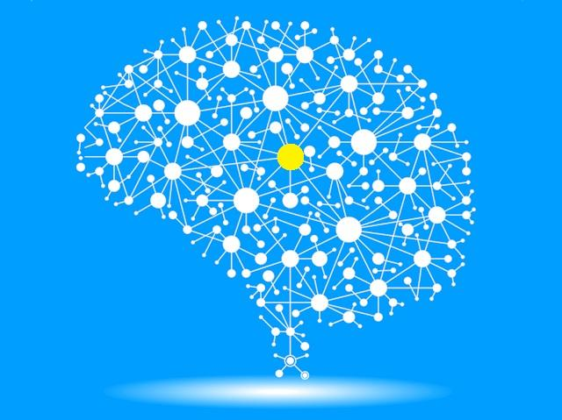
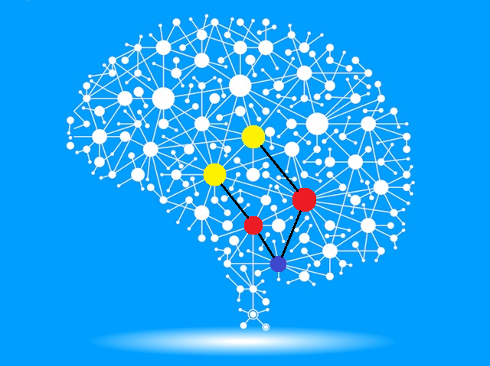
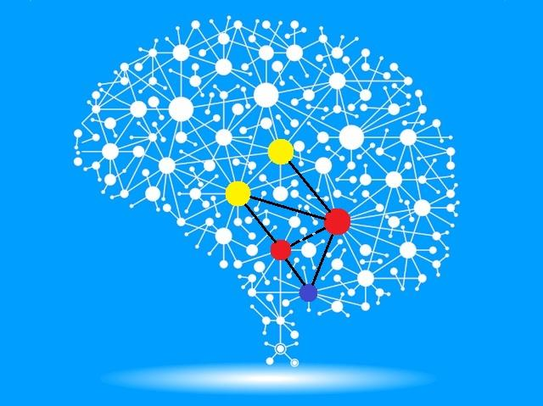
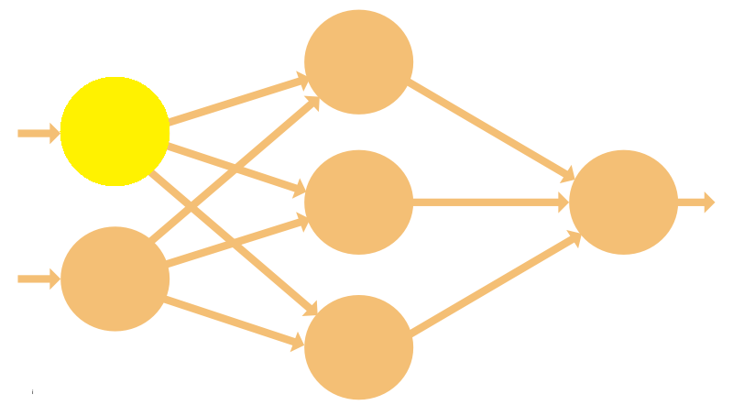
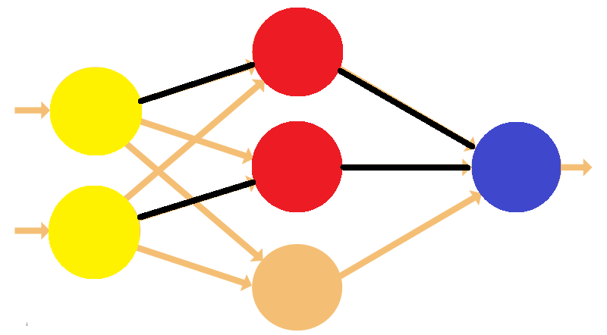
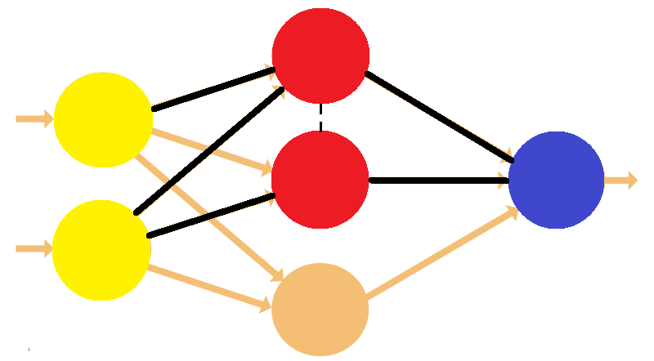
Organic Neural Learning
Similar to a human brain, a network of neurons could be
  Activated in an adaptive way according to the time-varying observed data
  Activated in an online fashion upon streaming data
  Re-configured to suit time-varying or multiple objectives
  Fused with other networks of neurons representing similar or different knowledge
see something
see more things
data
more data

Slide 3
Our Directions of Research
Sequential model expansion
  “organic in data size”
Collaborative learning
  “organic in loss functions”
Dimension reduction
  “organic in parameterization”
Multi-modal fusion
  “organic in features”
Online dictionary building
  “organic in model representation”
Our ongoing research
(we have preliminary results)
Our planning research
(we have related background research in classical time series settings)

Slide 4
Organic in Data Size
Motivation
  Data is sequentially observed on many real applications
  Fluctuation of data can change the selected model in an arbitrary manner
  The surrogate also requires the model change smoothly
    e.g. children brains grow gradually
  Candidate model dimensions smoothly and monotonically increase with data
Existing research
  Mathematically quantified the ``bigger model for bigger data’’ phenomenon in data analysis
  Applied the algorithm developed in FunLoL program to neural networks
  Sequentially increased the number of neural/connections upon the arrival of more data
  (ongoing) Implementing into a python package

Slide 5
  Organic in Loss Functions
Motivation
    Machine learning systems communicate with each other by sharing knowledge
    Learning elements in a networked system are not necessarily well-specified or reliable
    Each individual system in a network only possesses limited computational power
Existing research
  Established a mathematical framework for understanding the knowledge propagation through collaborative learning
  Developed fast algorithms and validated on classical statistical models
  (ongoing) Applying the framework and algorithms developed in FunLoL program to large-scale deep learning

Slide 6
  Organic in Parameterization
Motivation
    Existing architecture of deep learning heavily rely on the so-called “dropout” techniques which has been used to reduce the number of training parameters by random subsampling
    The existing dropout approach is not data-adaptive and therefore could not fully exploit the model redundancy inherited in neural networks
Existing research
  Propose ”data-adaptive” dropout techniques for fast re-parameterization of neural parameters
  (ongoing) Testing a new methodology based on mutual information for fast and reliable parameterization in neural learning

Slide 7
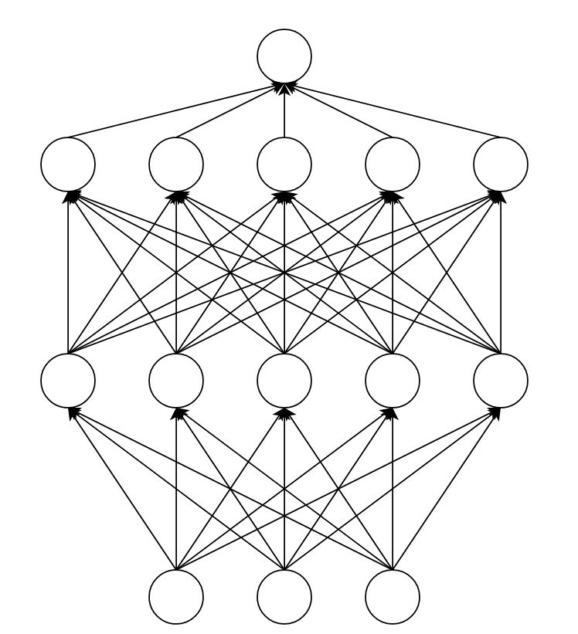
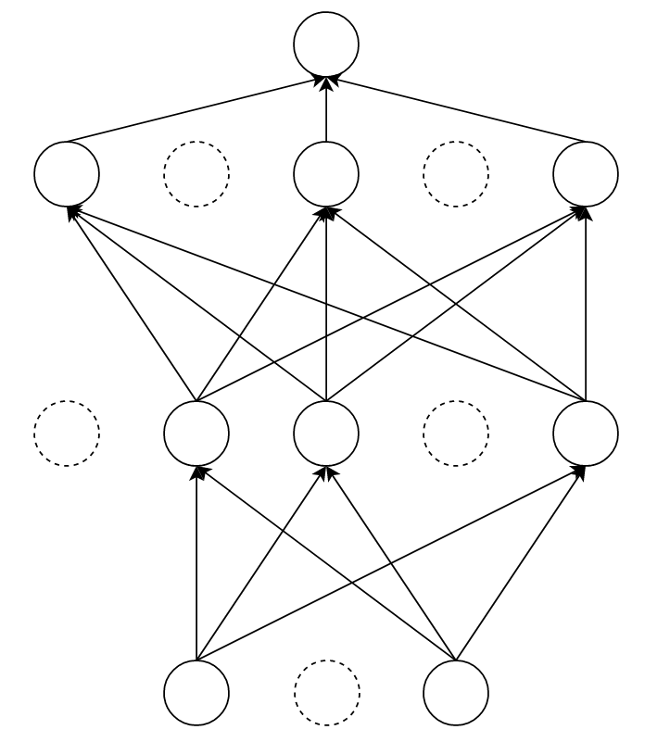
  Organic in Parameterization
Dropout
  Randomly set parameters to zero with probability p
Existing research
  Adaptively update dropout rate p
  (ongoing) Different parameters have different dropout rate p.
  Sequentially prune and re-parametrize Neural Network

Slide 8
  Organic in Features
Motivation
    Data sources are usually multi-modal, with different qualities, dimensions, and predictive power
    Existing approaches of feature fusion are usually heuristic (e.g. by simply fusing the features) and lack methodological guidance
  Existing approaches of feature-preprocessing/transformation are usually heuristic and require a lot of fine tuning
Planning research
  To propose ”data-adaptive” way of combining features from various sources, with potentially heterogeneous quality, dimension, functional relationship with responses, etc.
  To propose a theoretically-driven methodology on how to combine, transform, or eliminate features in an online and adaptive fashion

Slide 9
  Organic in Model Representation
Motivation
    Existing architecture of deep learning (e.g. those released on open-source platforms such as pytorch, theano, and tensorflow) are targeting at offline data
    More and more data in the era of big data are streaming, and we cannot afford the computational burden of repetitive batch-learning
    Many tasks (e.g. those in battlefields, transportation, medical care) cannot afford response delay, and online processing of any emerging event is a central matter of concern
Planning research
  To propose online dictionary building for neural processing of data
  To propose algorithms to detect change of abnormities, to memorize emerging regimes of models, to enable multi-task learning from online streaming data

